Slide 1

Interfaces and IComparer
Lecturer
Rokas Slaboševičius
Data

Slide 2
Today you will learn
Lecture title
What are interfaces?
01
How to use the IComparable interface?
02

Slide 3

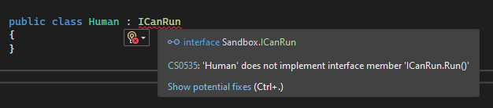
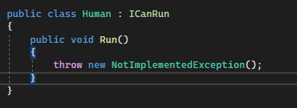
Interface, what is it?
Interfaces
An interface is a contract that a class "signs" to wrap in order to implement it.
Let's say we have the interface ICanRun (the naming convention for interfaces is with the letter "I" in front)
ICanRun declares a method void Run()
As you can see, a method has no body, interfaces refer to methods,
that the class inheriting this interface must implement.
After creating the Human class and inheriting from ICanRun we get an error
An error explicitly stating that the Human class must
implement the Run() method
Click on "Show potential fixes" to implement
method. As we can see, the method is created by default,
but inside the throwable error, here is the protection against
methods that have not been fully implemented.

Slide 4
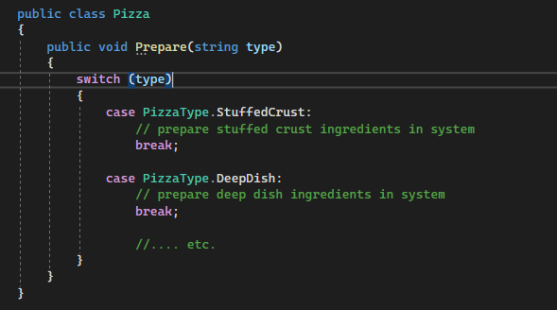
Interface, what is it?
Interfaces
Imagine that you are developing a pizza baking app using switch/case, as the application grows, we will very quickly encounter "bloated" code.
By checking each type individually, the Prepare method will become the method of hundreds of line length.

Slide 5
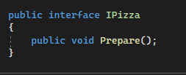
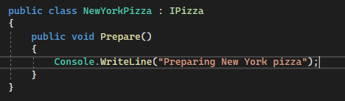
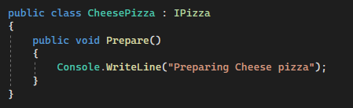
Interface, what is it?
Interfaces
One solution is to use interfaces.
We create an interface called IPizza.
The IPizza contract will bind all pizza classes
implement the Prepare() method

Slide 6
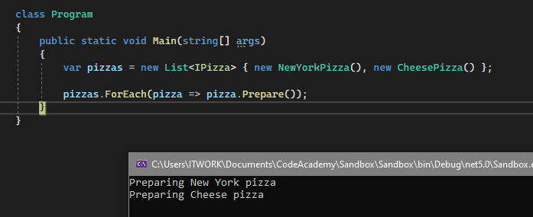
Interface, what is it?
Interfaces
That way, with a list of pizzas, we can easily "cook" them all ;)
Sample pizzas from: https://stackoverflow.com/questions/6802573/interfaces-whats-the-point

Slide 7

Interface, what is it?
Interfaces

Slide 8

Interfaces
Task 1
Create an interface named IVehicle with methods Drive and Refuel (you can choose the type of return yourself and how you implement it, you can also do it with void)
Then create a class Car that implements this interface and also has properties string Model and int Fuel.
Implement the necessary methods, the Drive() method must check if the fuel is not running out, if not, the vehicle is ready to drive. The Refuel method must check that the amount to be refilled is not negative (you can also make a maximum fuel tank size, but think how you will use that functionality)

Slide 9
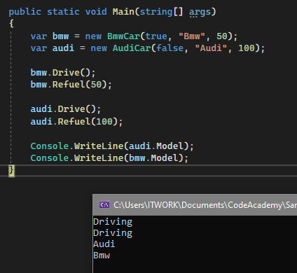
Interfaces
Task 2
Modify the programme for the first task.
Make the Car class abstract and add the property string Model.
Create a class BmwCar that inherits from the Car class and has its own property bool IsXDrive.
Create an AudiCar class that inherits from the Car class and has its own property bool IsQuattro.

Slide 10
IComparer<>
Interfaces
"Exposes a method that compares two objects."

Slide 11
IComparer<> Example
Interfaces
With a list of strings, the list.Sort() method is very obvious - it sorts the list alphabetically.
If we have a list of more complicated objects like Car, sorting the list becomes less obvious. Which property do we want the program to sort the list by?
That's what the IComparer<> interface is for.

Slide 12

IComparer<> Example
Interfaces
We modify the existing car programme.
We won't need to move the existing code, just add new code.
We create a class BmwCarComparer and inherit the IComparer interface, specifying BmwCar as the data type.
We will have to implement the Compare method right away.
When implemented, we get an empty method with a throwable exception.
Let's say we want our list to be sortable
alphabetically by car model.
Compare method return is written as follows:

Slide 13
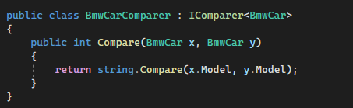
IComparer<> Example
Interfaces
The principle of the IComparer Compare() method is to return -1 0 or 1 according to the condition, which the interface uses to find out whether the value is less than or greater than.

Slide 14
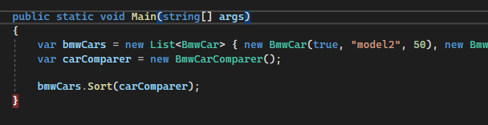
IComparer<> Example
Interfaces
Let's create a list of bmwCar objects.
Then let's create a new comparer and use it to sort the list.
Start the app and make sure the list
is sorted alphabetically by machine model.

Slide 15
Interfaces
Task 3
Implement the IComparer interface for other car types.

Slide 16
Interfaces
Interfaces and IComparable
https://docs.microsoft.com/en-us/dotnet/csharp/language-reference/keywords/interface
https://docs.microsoft.com/en-us/dotnet/api/system.collections.icomparer?view=net-6.0
Useful information

